Slide 1
Wine Quality Prediction
Summer internship program
Team Name-
Data Pyrates
Team Members:-
Abhinav Bajaj
Apoorav Nigam
Krishna Nathwani
Nasir Hussain
Submitted to:-
Miss. Ramya Guntamukkala

Slide 2
Introduction
Wine classification is a difficult task since taste is the least understood of the human senses
Today, all types of industries are improving by adopting new technologies and applying them in all areas
This project is created to predict the quality of Wine
The random forest algorithm implemented to determine dependency of wine quality on different 13 physicochemical characteristics
The predictions are also made for wine quality on the basis of important variables/characteristics, selected according to their dependencies

Slide 3
Objective
To visualize and understand the given database by using graphs, diagrams and images
To test the dataset using different machine learning algorithms and find the best one
To fit the dataset into the best model
To predict which classification the input given by the user belongs to
Finally to make the User Interface for easy use of the application

Slide 4
Technologies Used
Operating System: Machine Learning is platform independent, it can be accessed on Android, Windows, Linux or any other OS the user wishes to open
Programming Languages: Python
Tools: The tools used to create the project are:
IBM Cloud
IBM Watson studio
Node – Red
Jupyter Notebook

Slide 5
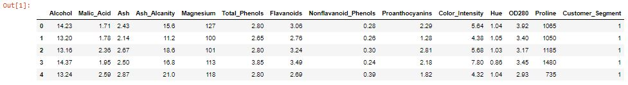
Data Set
We use a dataset containing different ingredients used in making Wine
Data Sample:

Slide 6
Algorithm
Different dataset need different algorithms
We need to identify the best algorithm among them by getting the correct accuracy and efficiency
Here we used ‘Random Forest Algorithm’ for our dataset
Since we has the dataset of more then one independent variables and a dependent variable that has categorized values so we use the classification algorithm

Slide 7
Why we use ‘Random Forest’?

Slide 8
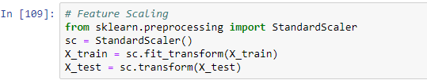
Methodology
First the dataset was uploaded and inserted in the Jupyter Notebook
The X and y variables were then initialized where y the dependent category and X has all the independent values
Then the data is spilt into test and train data and fit in the model

Slide 9
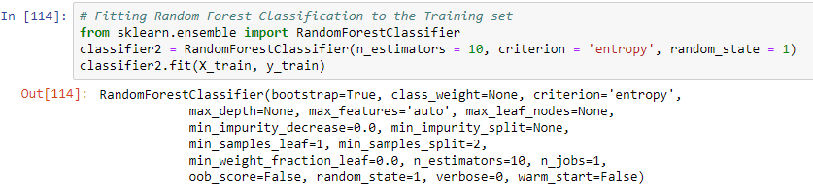
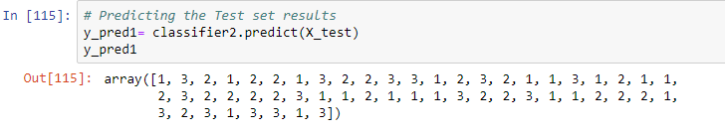

Predicting Accuracy
We have used the Random Forest algorithm to create the classifier needed to fit the model
The .predict function is then called to predict the values of X_test
We then score the predicted value according to its accuracy
As we can see the accuracy is 93.6% so the model was successfully trained and tested

Slide 10
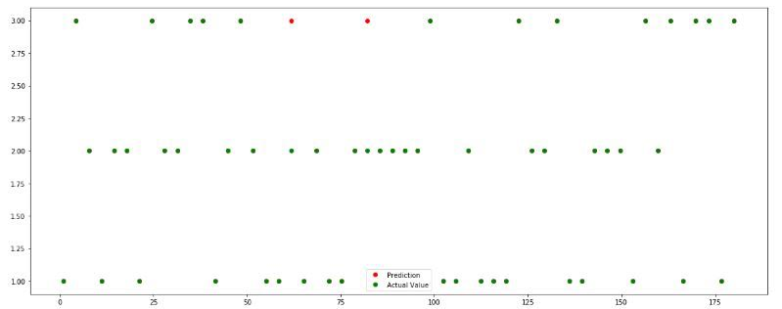
Graph

Slide 11
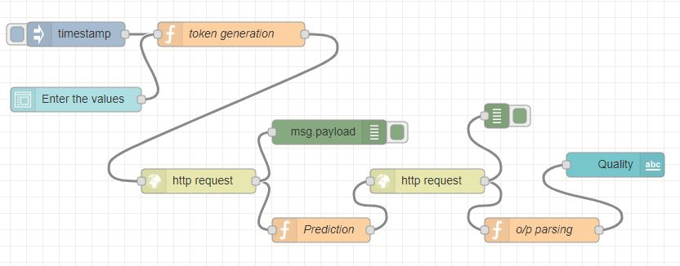
Creating UI
For the UI we use the Node-Red Editor
Drag and drop multiple nodes to create complete UI
We uses the nodes like timestamp for injecting input, function to define method, form to input the values, http request to GET and POST the dataset, payload for debugging the response and text node for the output

Slide 12
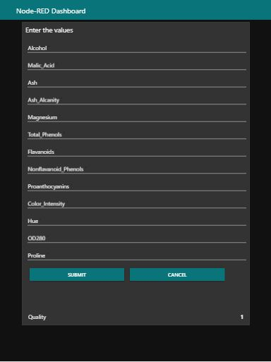
UI Sample and Working
A simple web app
Form to input the values
Insert and submit the values to get output
Get the output as ‘Quality’ text view

Slide 13
Conclusion
The algorithm we used is efficient to predict the quality of Wine
With this model we are close enough to successfully predict the quality of Wine
We got the accuracy of 93.61% there is no such algorithm derived that can predict 100% accuracy
Machine Learning overall is a very powerful tool to revolutionize the way things work
It is very user-friendly and hence helps the user to predict the data easily and simultaneously keep improving the accuracy and efficiency by itself

Slide 14
Thank-you
Presented by-
Data Pyrates

